Slide 1
{Growth} Hacking to Better Security
John Lambert, @JohnLaTwC
Microsoft Threat Intelligence Center

Slide 2
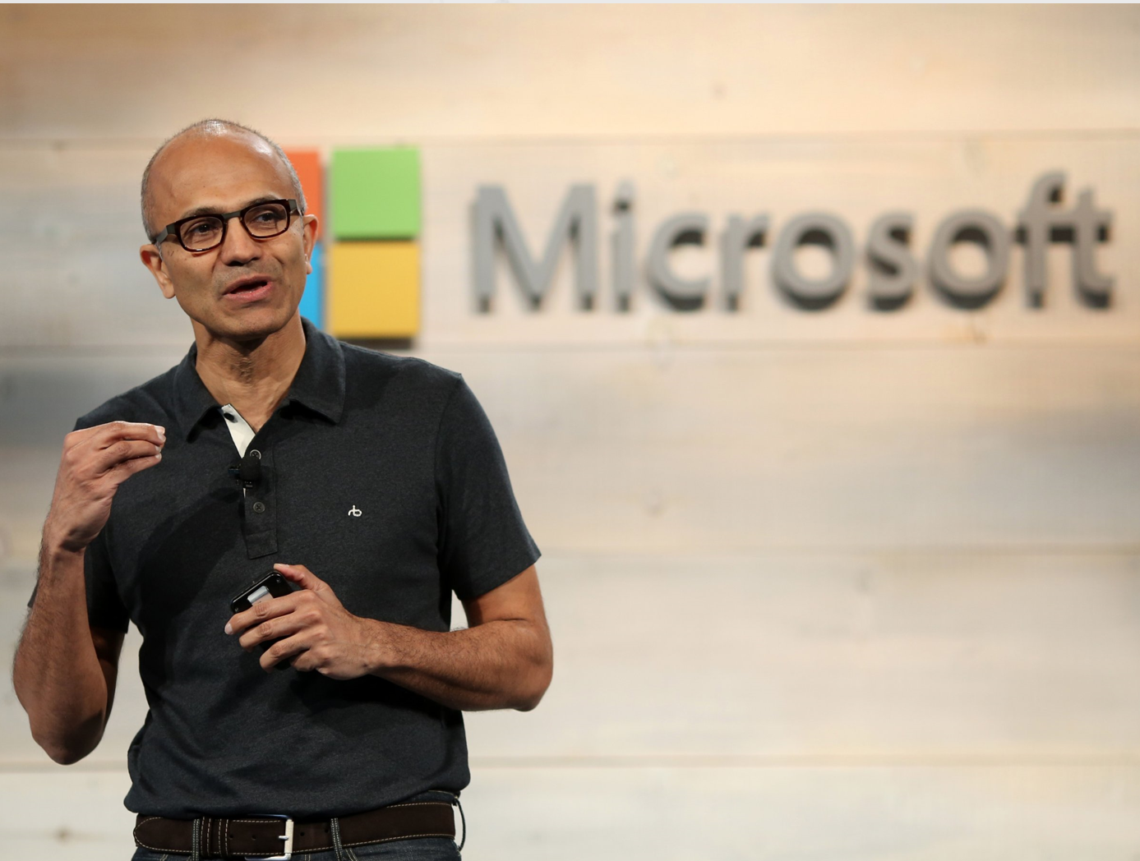
Satya Talks “Growth”
Growth Hacking
Rapid experimentation to identify the most efficient ways to grow a business
Characterized by Data, Experimentation, Curiosity
Growth Mindset
Focus on learning from others
Contrast with “fixed mindset” where talent is believed to be innate v. something that can be improved with effort
Know-it-all → Learn-it-all

Slide 3
How to help teams learn as fast as possible?

Slide 4
Accelerating Learning in InfoSec
Kn
Organized Knowledge
Ex
Executable Know-How
Co
Re
Repeatable Analysis
Community
Au
Automation

Slide 5
If you want to go fast, go alone If you want to go far, go together African Proverb

Slide 6
Organized Knowledge

Slide 7
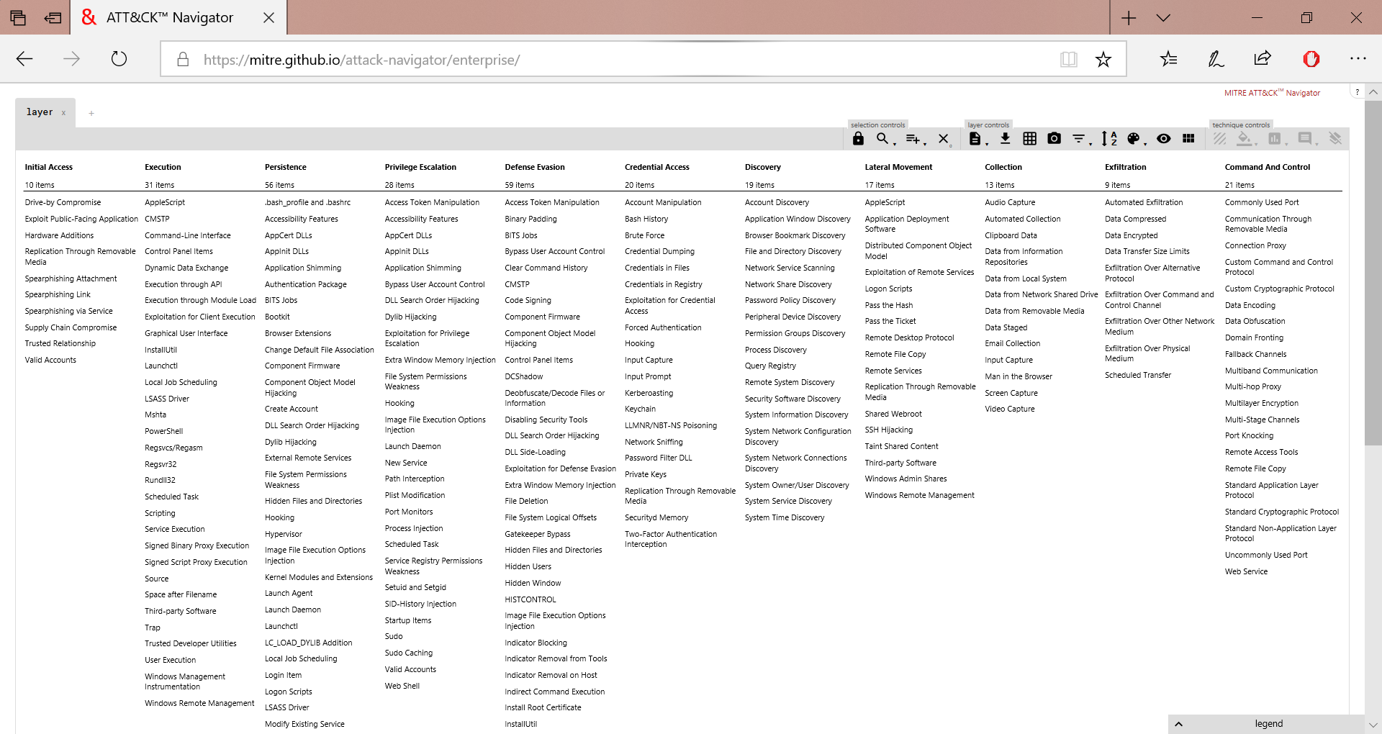
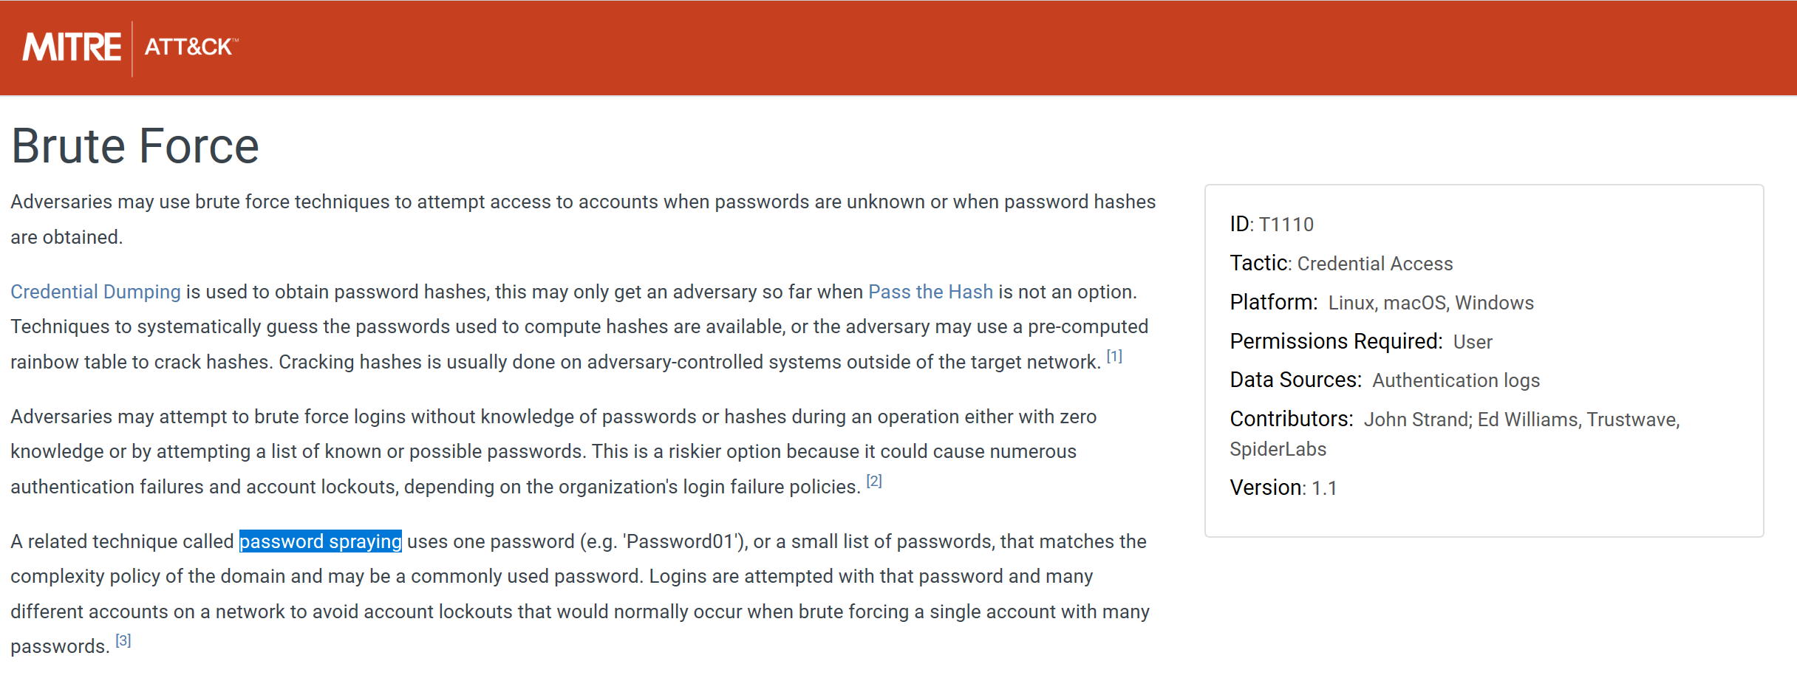
Knowledge
Which password is stronger?
Winter 2019
1qaz@WSX

Slide 8
Activity Groups
H
hydrogen
1
He
helium
2
Li
lithium
3
Be
beryllium
4
B
boron
5
C
carbon
6
N
nitrogen
7
O
oxygen
8
F
fluorine
9
Ne
neon
10
Over 110 groups known to us
Over 70 full-fledged Activity Groups
Na
sodium
11
Mg
magnesium
12
Al
aluminium
13
Si
silicon
14
15
P
phosphorous
S
sulphur
16
Cl
chlorine
17
Ar
argon
18
K
potassium
19
Ca
calcium
20
Sc
scandium
21
Ti
titanium
22
V
vanadium
23
Cr
chromium
24
Mn
manganese
25
Fe
iron
26
Co
cobalt
27
Ni
nickel
28
Cu
copper
29
Zn
zinc
30
Ga
galium
31
Ge
geramanium
32
33
As
arsenic
Se
selenium
34
Br
bromine
35
Kr
krypton
36
Rb
rubidium
37
Sr
strontium
38
Y
yttrium
39
Zr
zirconium
40
Nb
niobium
41
Mo
molybdenum
42
Tc
technetium
43
Ru
ruthenium
44
Rh
rhodium
45
Pd
palladium
46
Ag
silver
47
Cd
cadminium
48
In
indium
49
Sn
tin
50
51
Sb
antimoney
Te
tellurium
52
I
iodine
53
Xe
xenon
54
Cs
caesium
55
Ba
barium
56
Hf
hafnium
72
Ta
tantalum
73
W
tungsten
74
Re
rhenium
74
Os
osminium
76
Ir
iridium
77
Pt
platinum
78
Au
gold
79
Hg
mercury
80
Tl
thallium
81
Pb
lead
82
83
Bi
bismuth
Po
polonium
84
At
astatine
85
Rn
radon
86
Rf
rutherfordium
112
104
Db
dubnium
105
Sg
seaborgium
106
Bh
bohrium
107
Hs
hassium
108
Mt
meitnerium
109
Ds
darmstadtium
110
Rg
goentgenium
111
Cn
copernicium
Nh
nihonium
113
Fl
flerovium
114
Mc
moscovium
115
Lv
livermorium
116
117
Ts
tennessine
Og
oganesson
Fr
francium
118
Fr
francium
87
Ra
radium
Ra
radium
88
La
lanthanum
57
Ce
cerium
58
Pr
praseodymium
59
Nd
neodymium
60
Pm
promethium
61
Sm
samarium
62
Eu
europium
63
Gd
gadolinium
64
Tb
terbium
65
Dy
dysprosium
66
Ho
holmium
67
Er
erbium
68
Tm
thulium
69
Yb
ytterbium
70
Lu
lutetium
71
Ac
actinium
89
Th
thorium
90
Pa
protactinium
91
U
uranium
92
Np
neptunium
93
Pu
plutonium
94
Am
americium
95
Cm
curium
96
Bk
berkelium
97
Cf
californium
98
Es
einsteinium
99
Fm
fermium
100
Md
mendelevium
101
No
nobelium
102
Lr
lawrencium
103

Slide 9
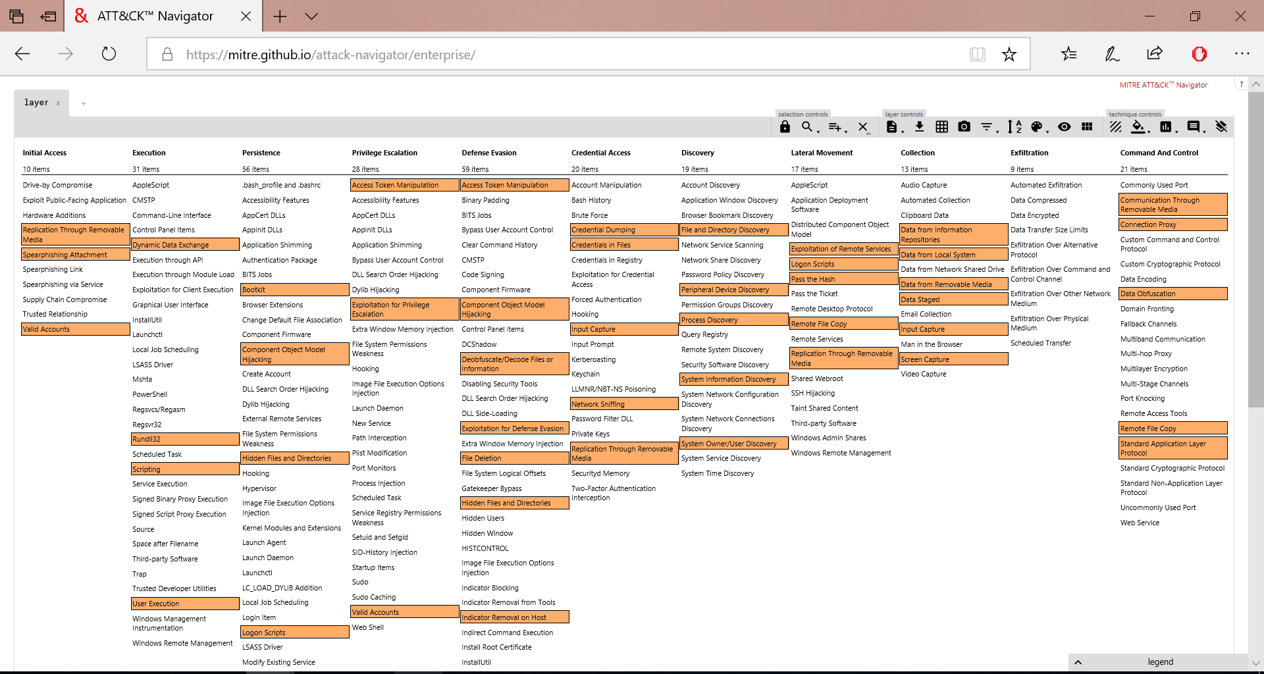
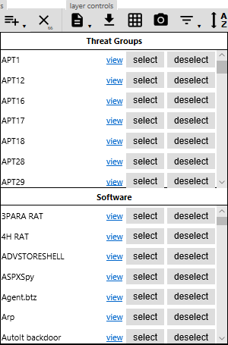

Slide 10
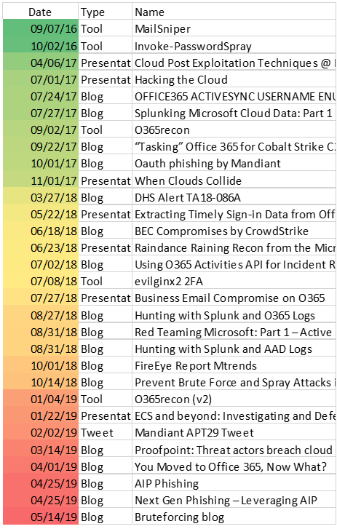
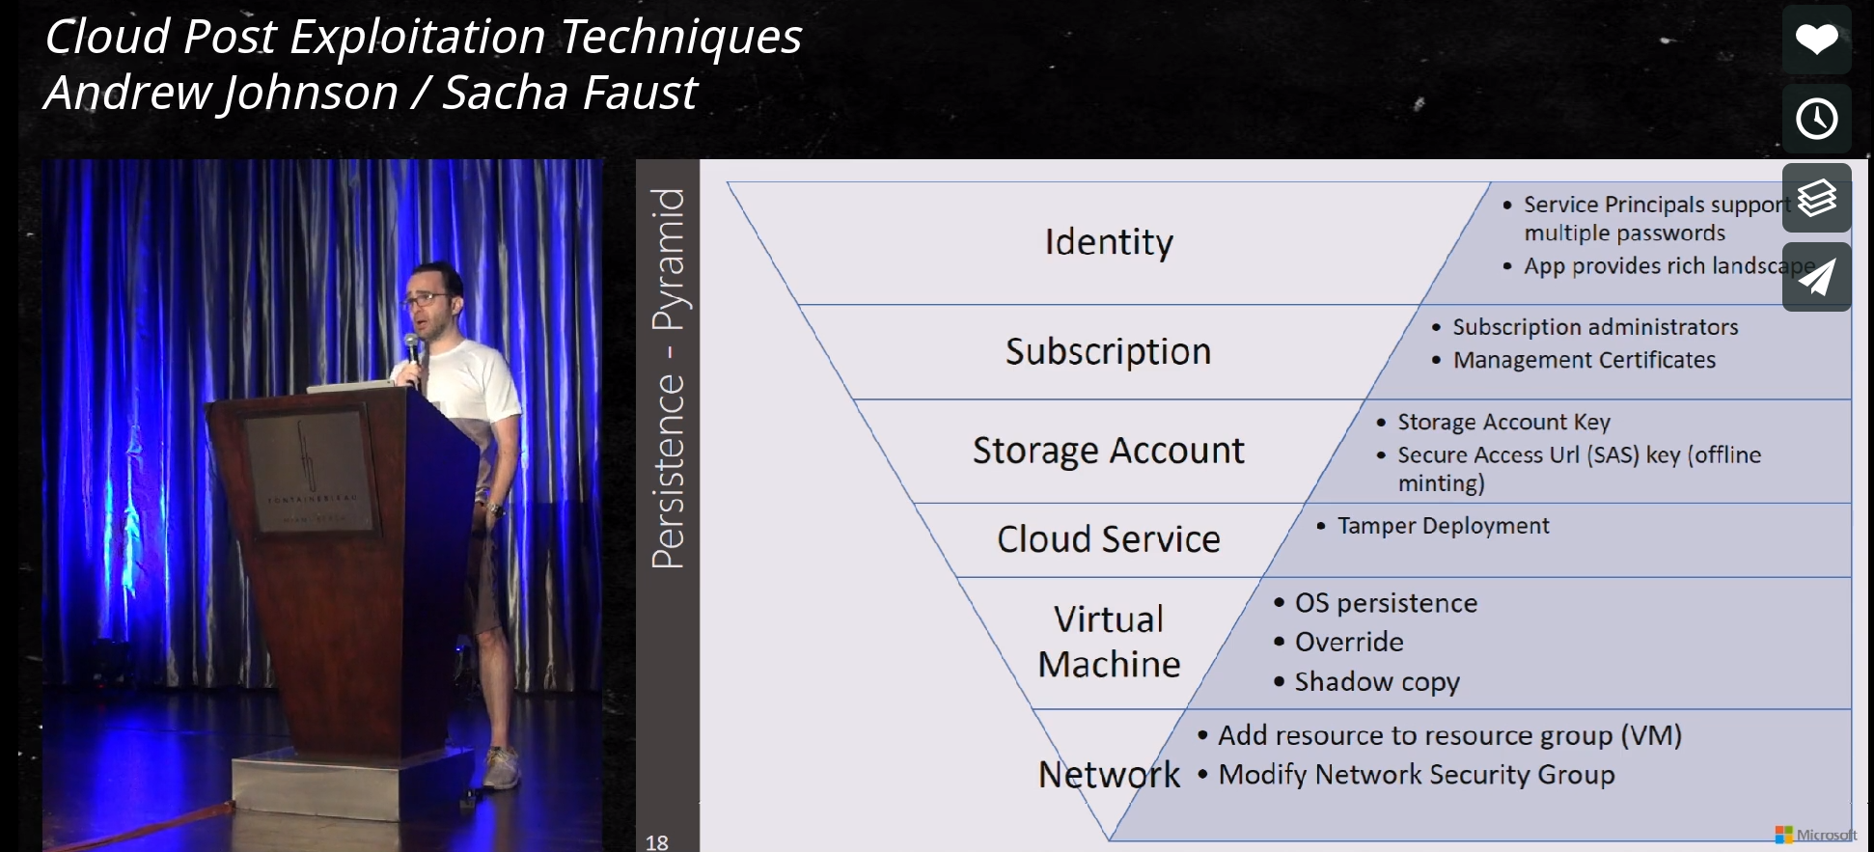
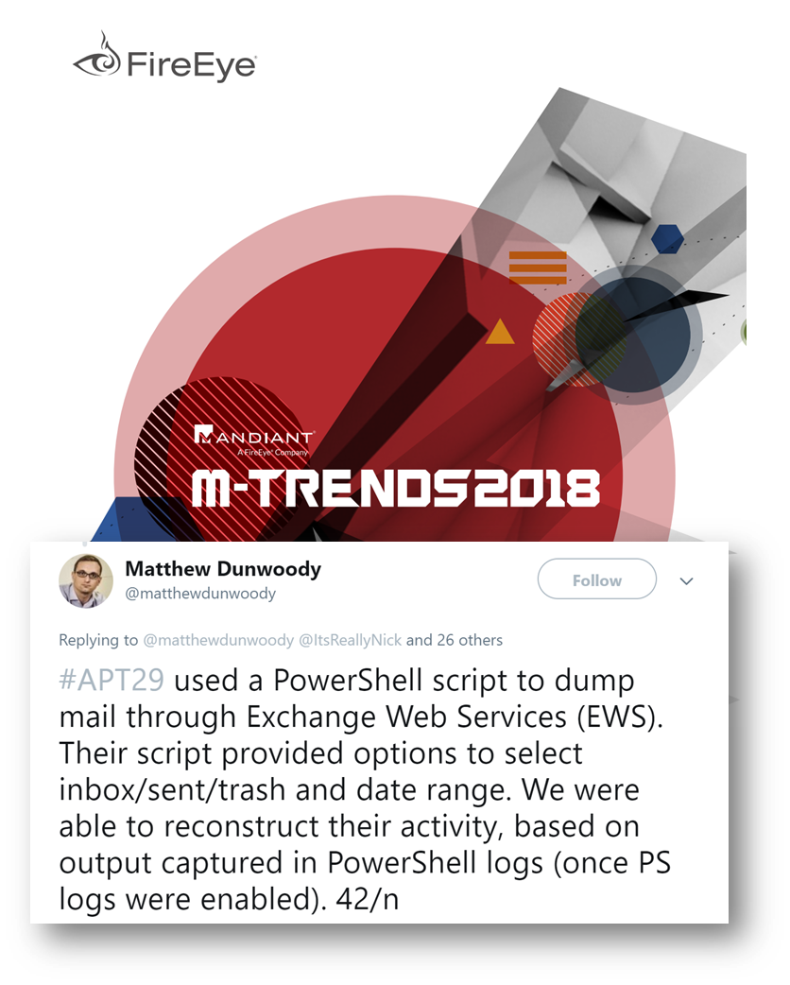
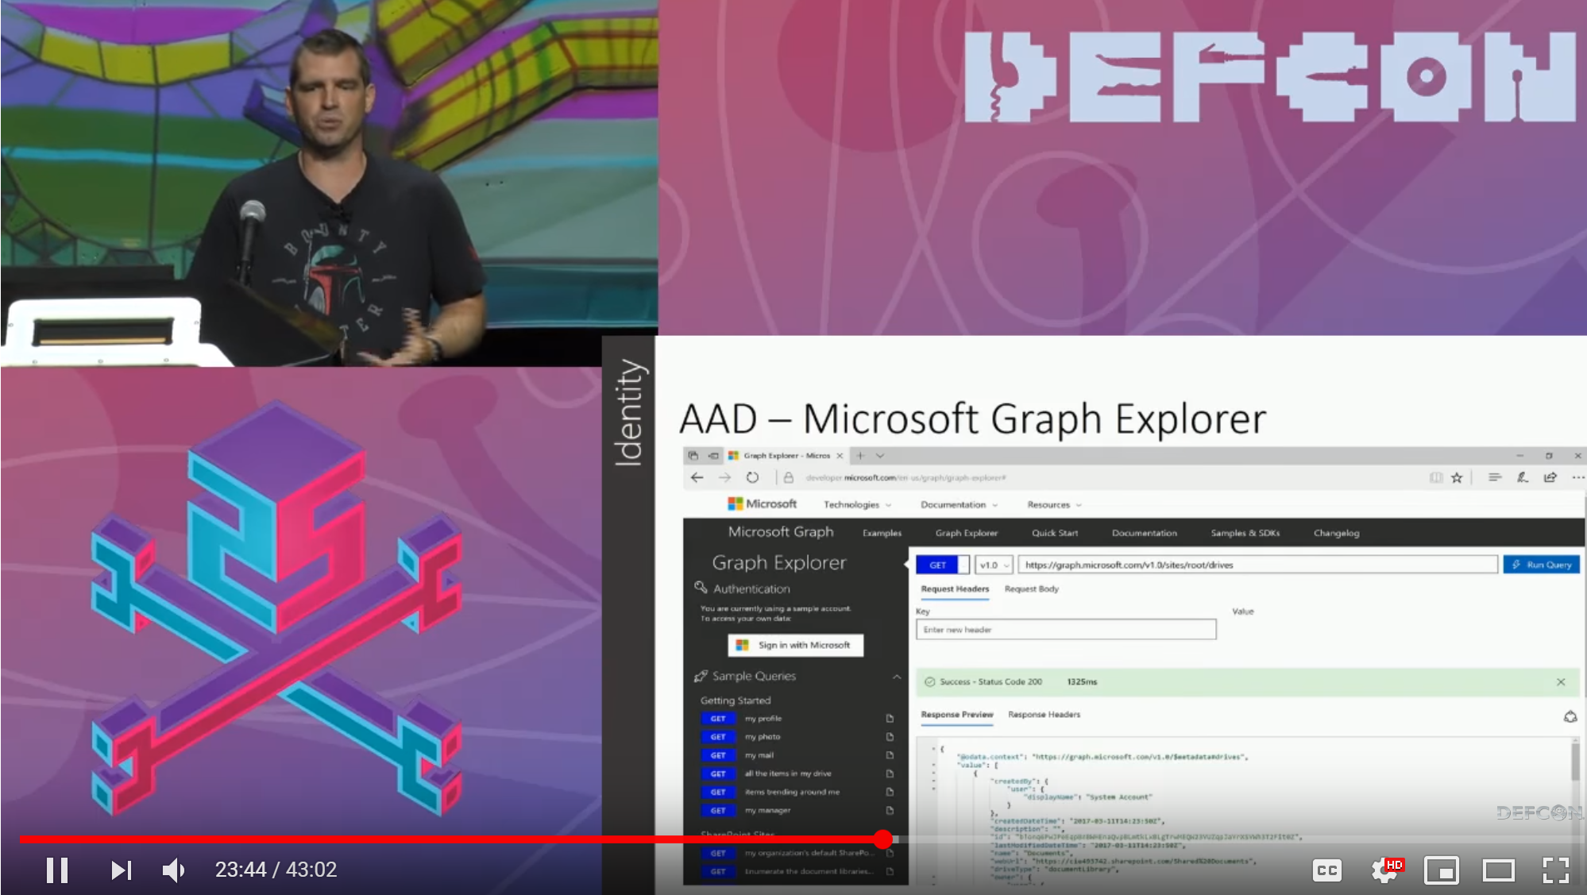
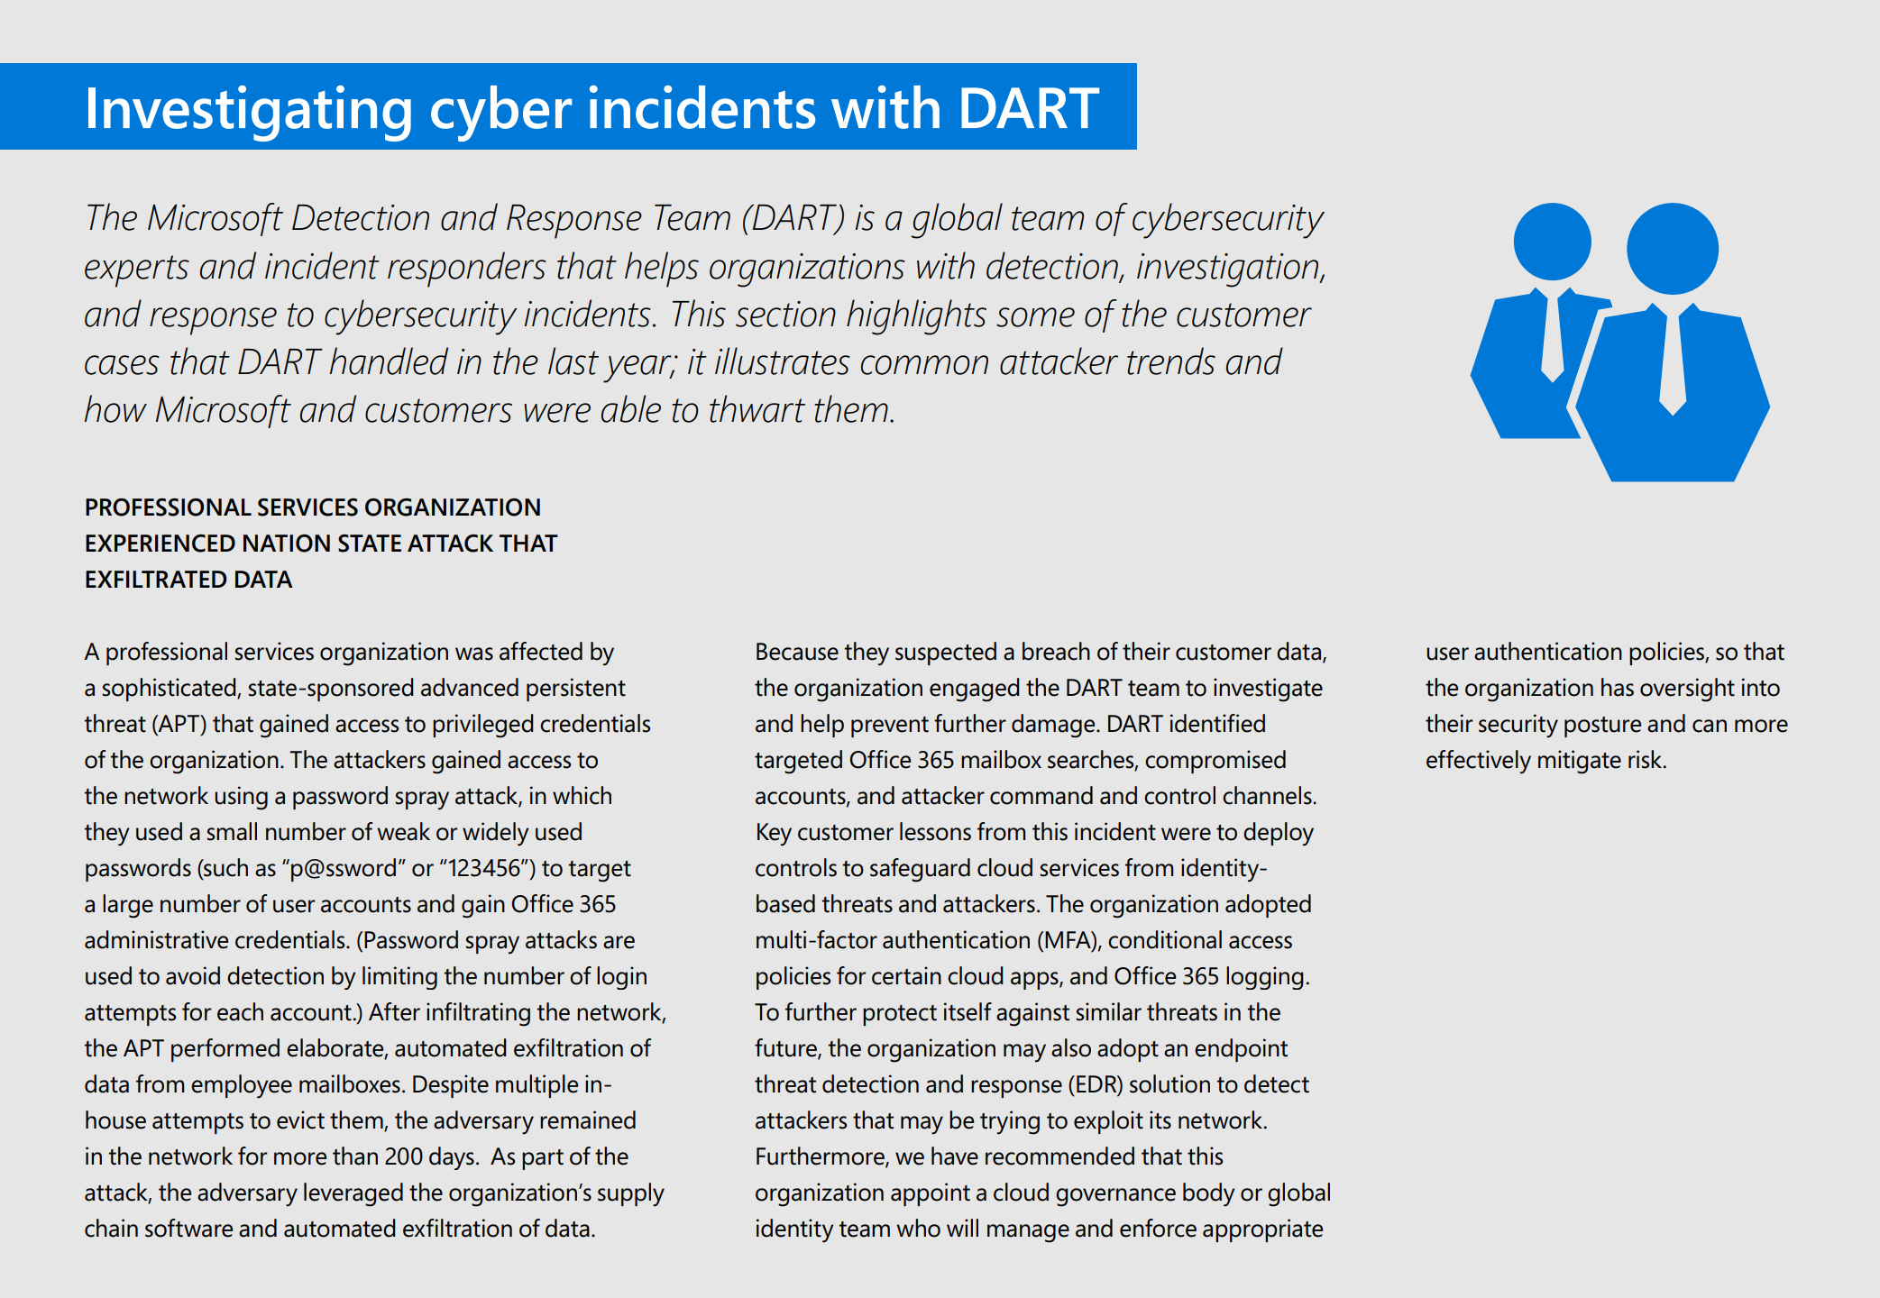
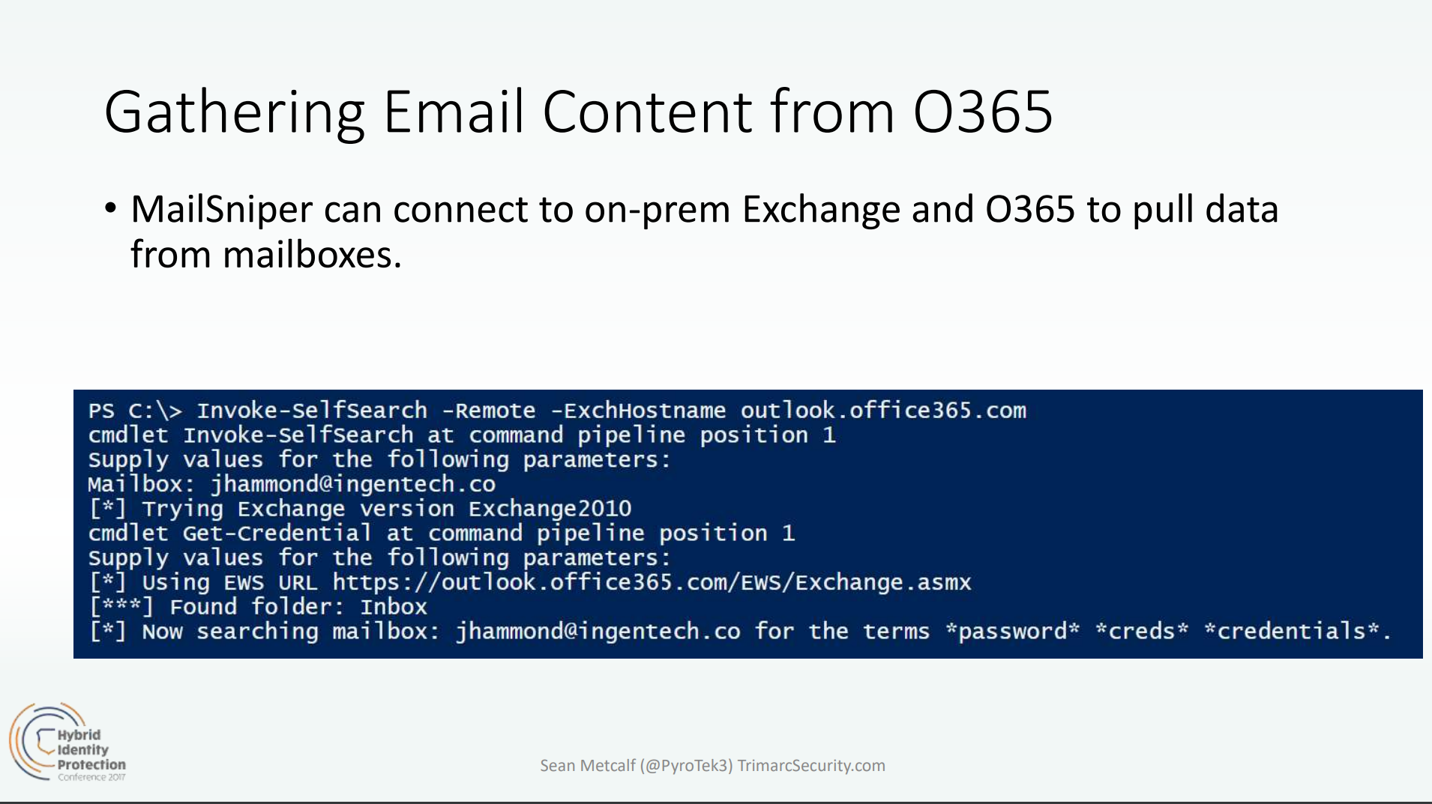
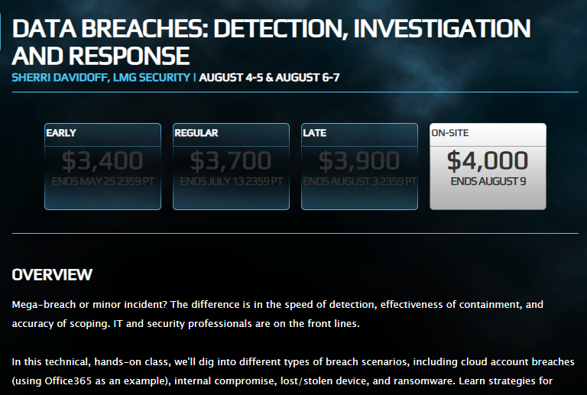
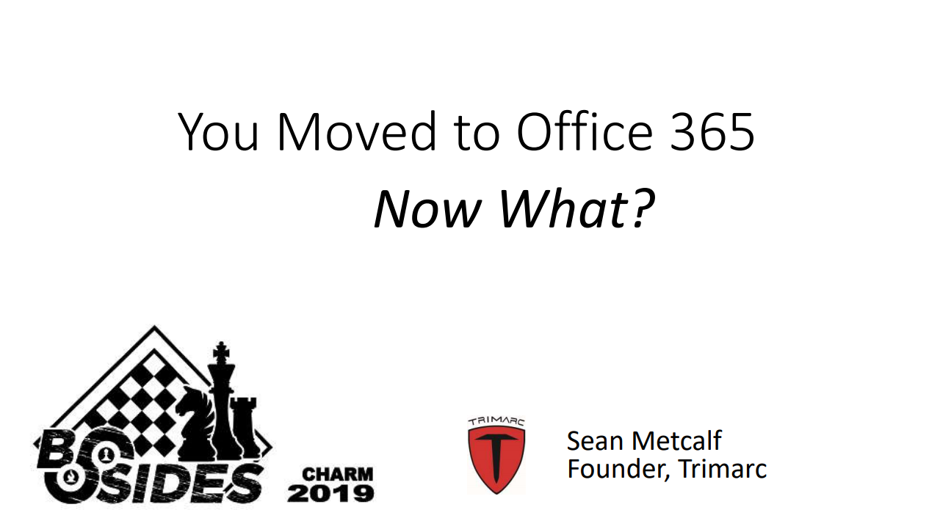
Researcher Interest in O365 Increasing
Presentations and Tools
Attacks
Cloud Post Exploitation Techniques @ Infiltrate 2017
“DEF CON 25 (2017) – Hacking the Cloud
Security in a Cloud-Enabled Environment
Blackhat 2018 Training
B-Sides 2019

Slide 11
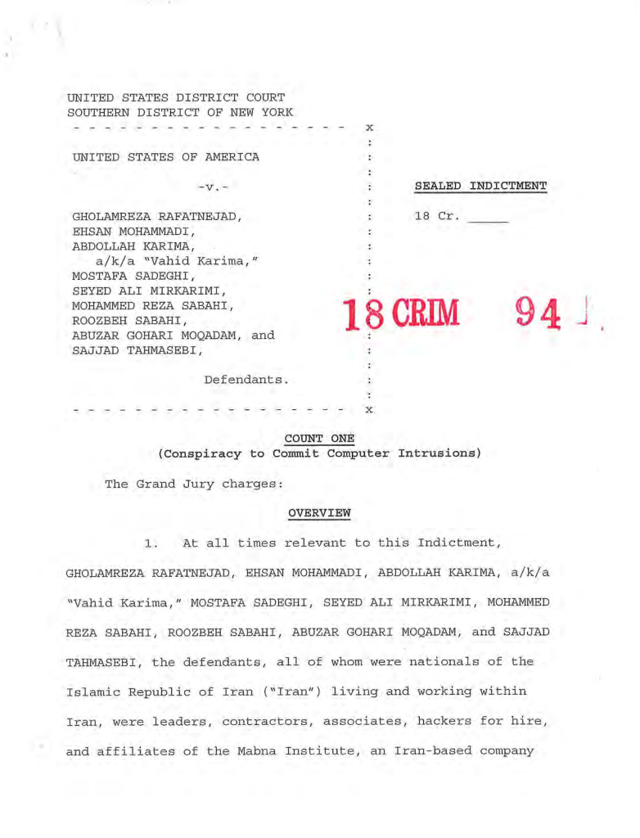
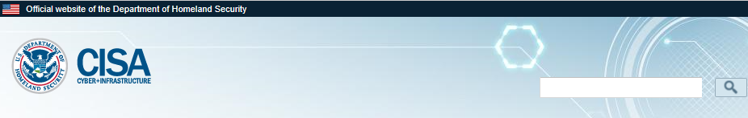
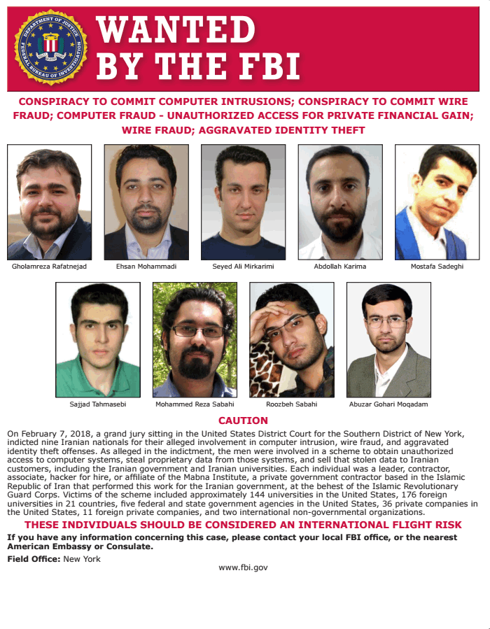
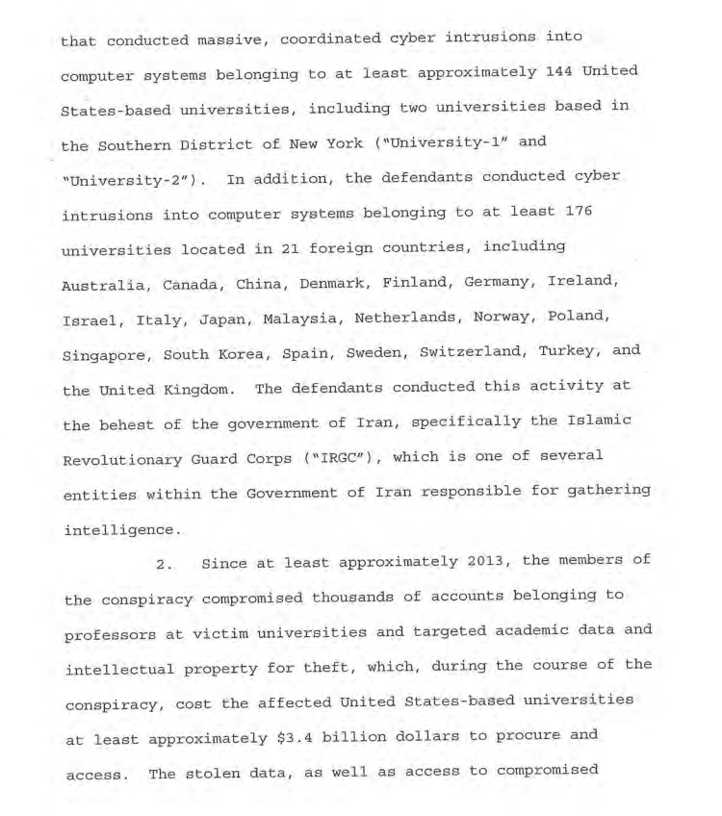
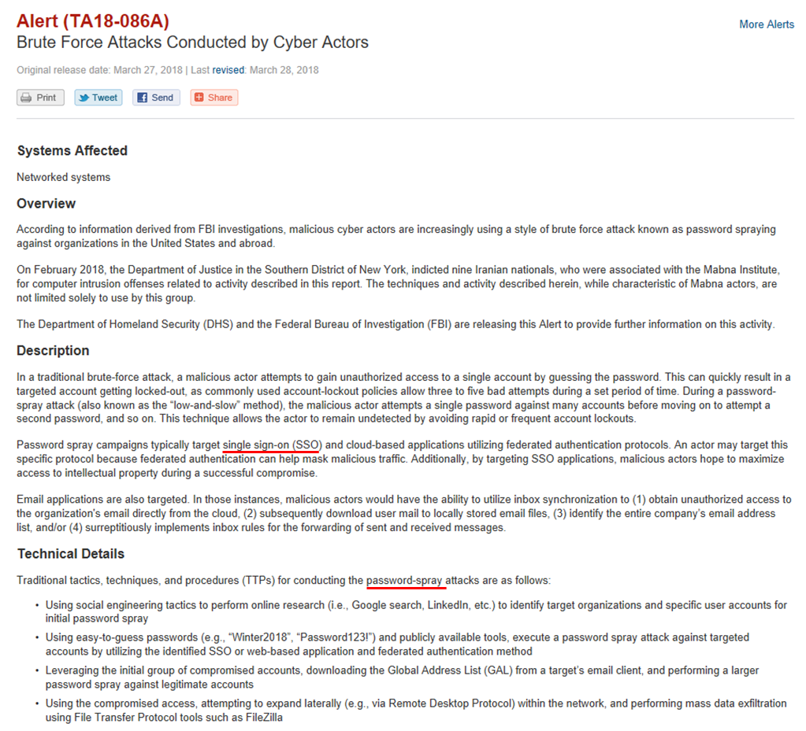
Iranian hackers indicted by DOJ after targeting cloud customers
https://www.justice.gov/usao-sdny/press-release/file/1045781/download

Slide 12
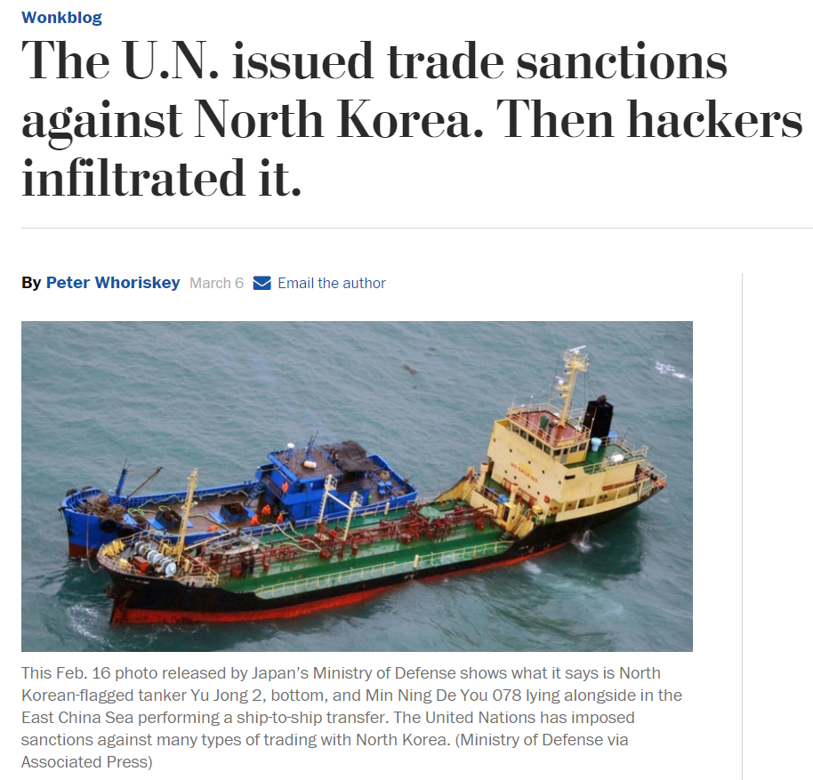
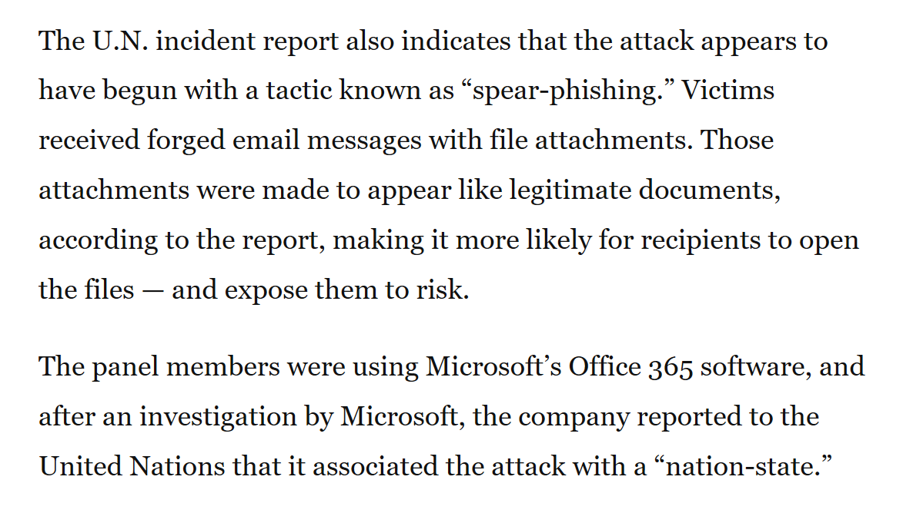
Credential Attacks - THALLIUM

Slide 13
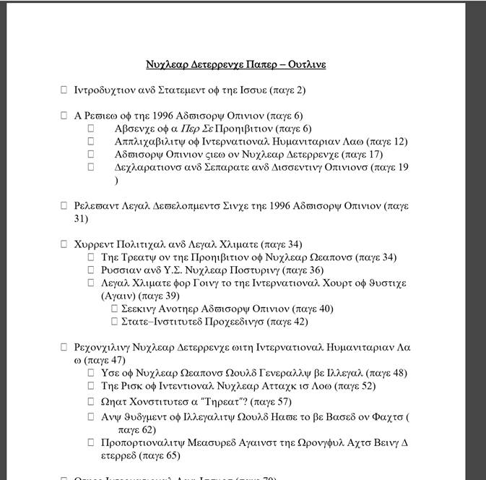
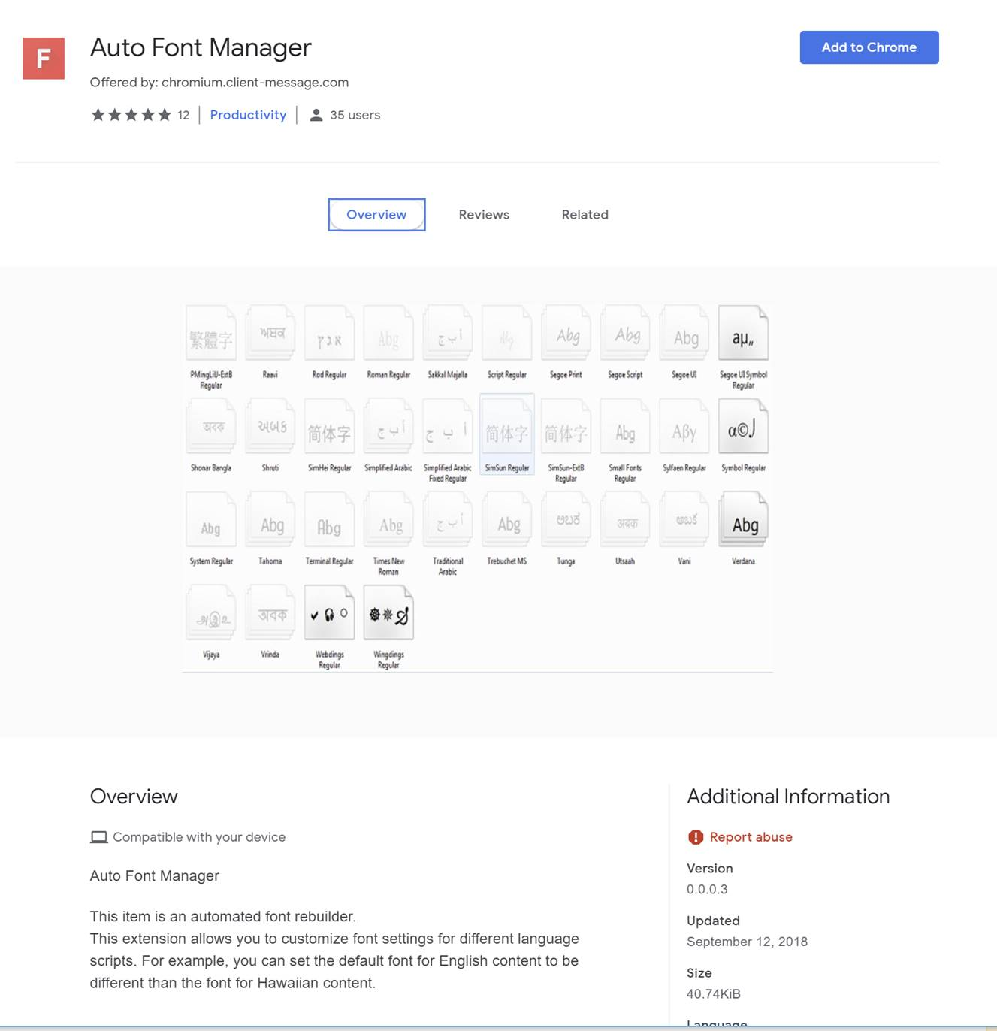
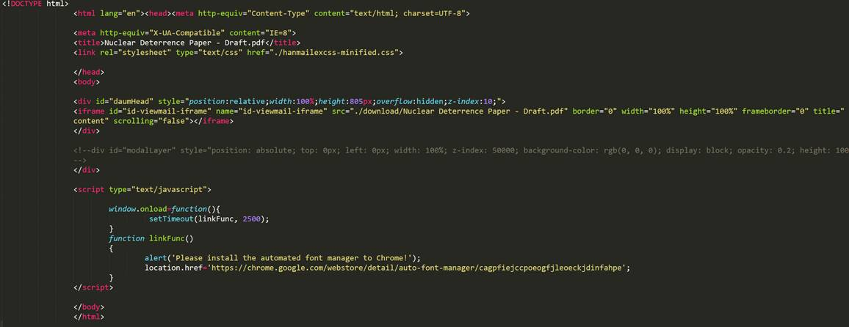
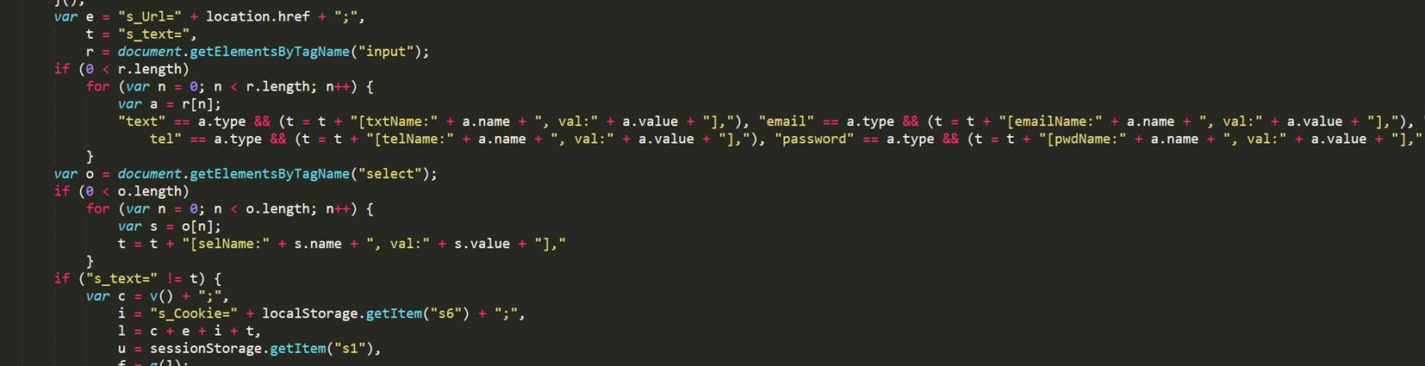
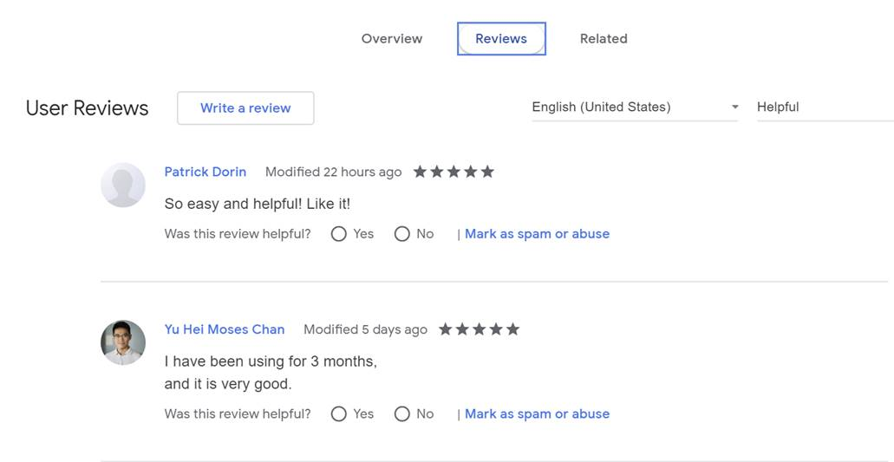
THALLIUM Attack
'google.c'
'outlook.c’
‘<victim specific domain>'
'yahoo.c'
'aol.com'
'microsoftonline.com'

Slide 14
Attack Techniques

Slide 15
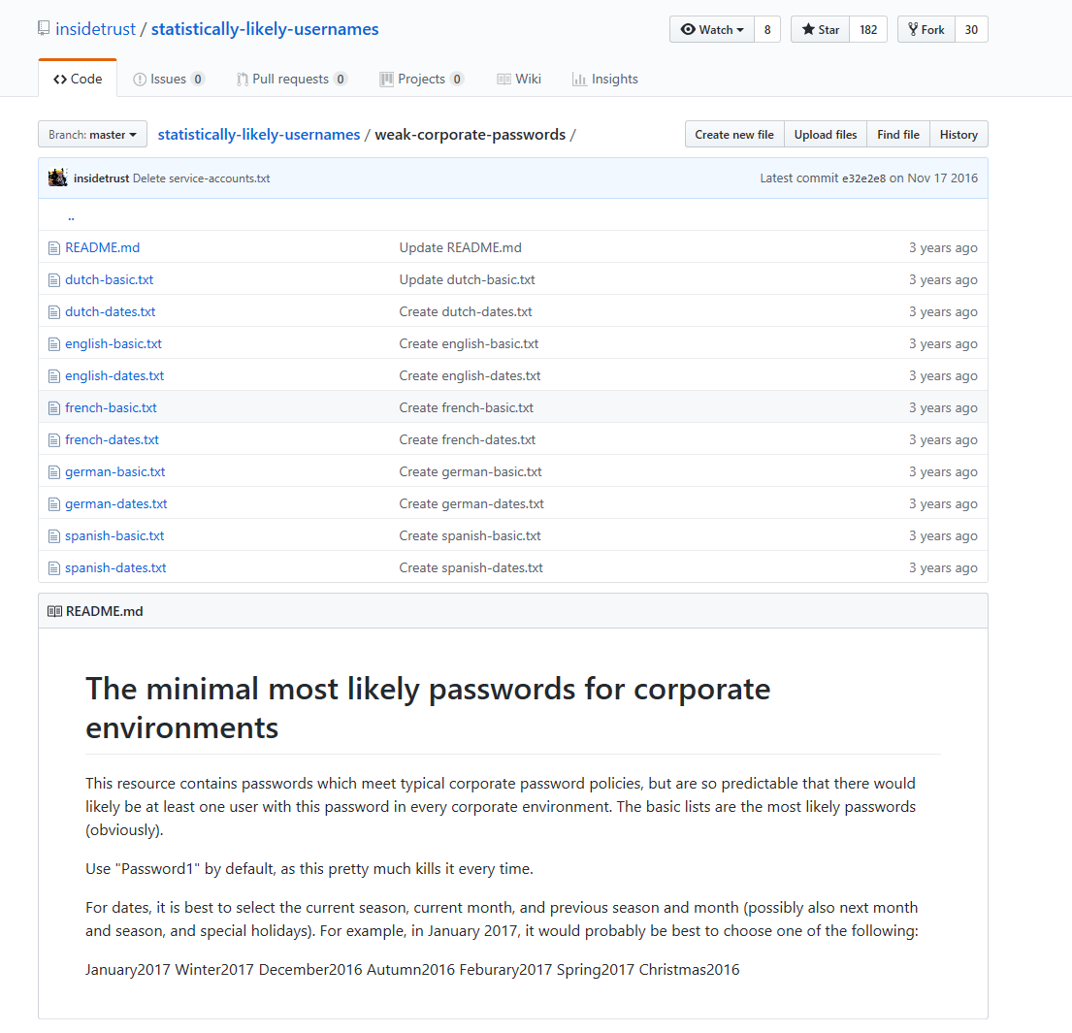
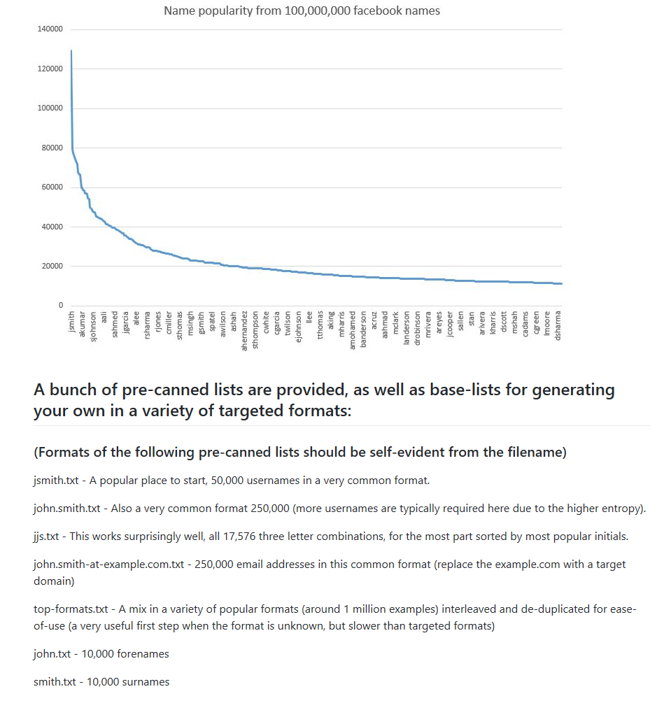
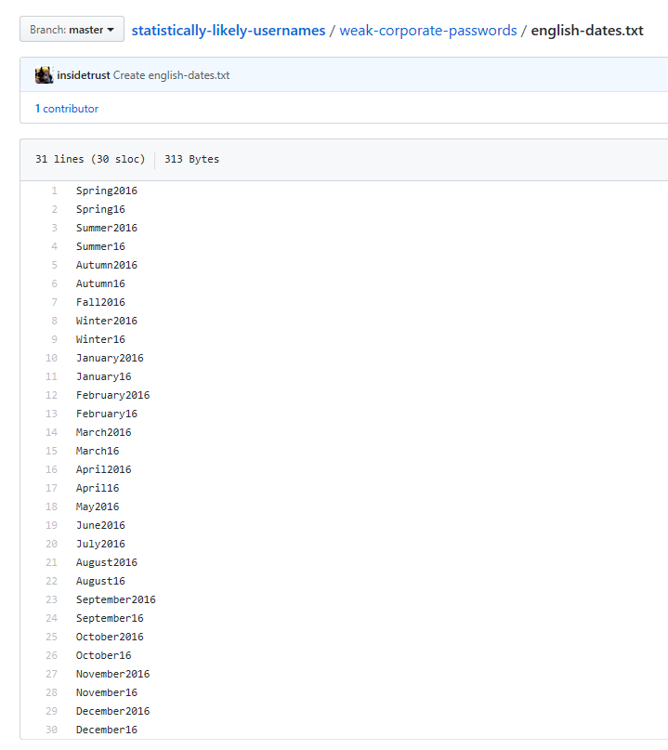
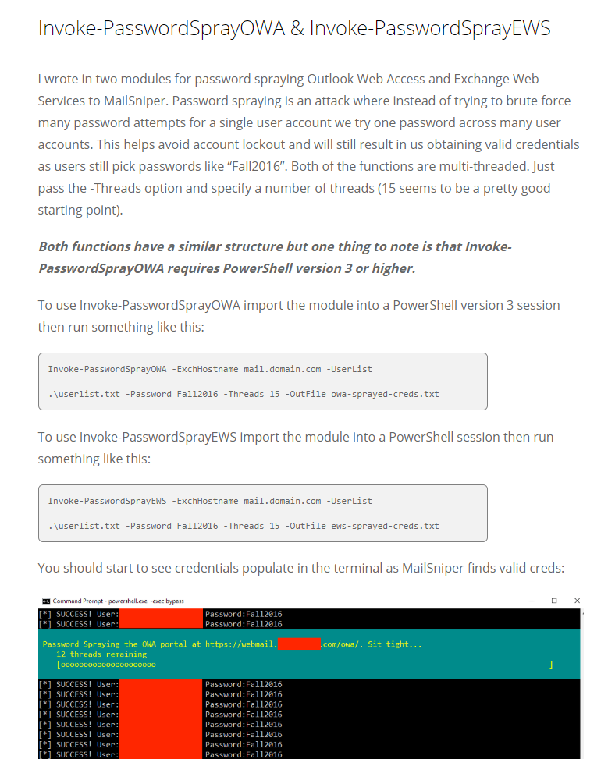
Password Spray (on steroids)

Slide 16
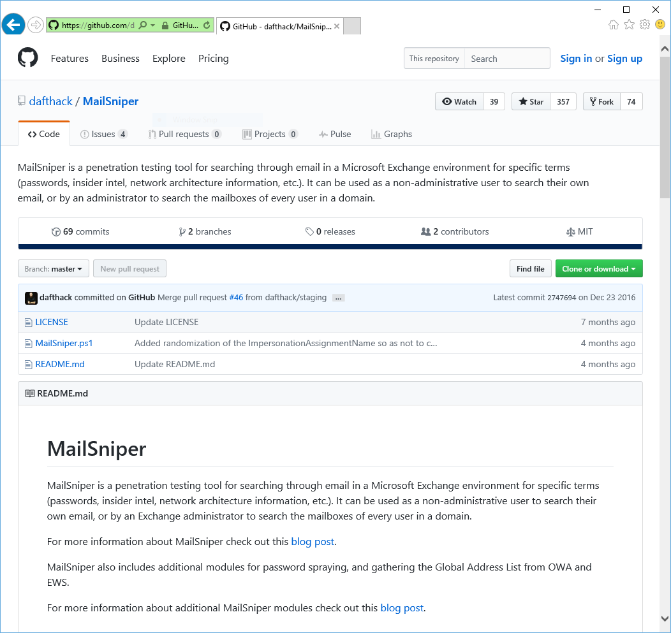

Mail Sniper
PowerShell script pen test tool used against Exchange Web Services (EWS)
Works against EWS endpoint
If not known, Autodiscover process helps to locate the EWS endpoint URL
Integrates Password Spray module

Slide 17
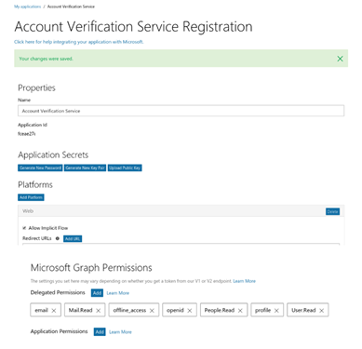
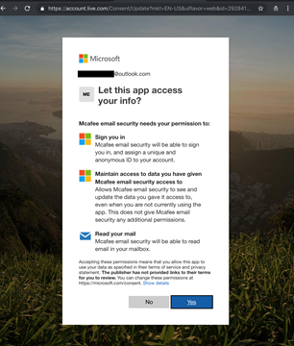
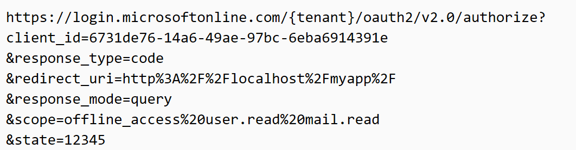
Phishing: 2FA bypass with OAuth Phishing
Step 1: Attacker registers an app with AAD with permission to read user mailbox
Step 2: Attacker crafts a mail with a link to authorize the app
Note: the URL is entirely hosted at Microsoft making it trickier to know it is a phishing site
Step 3: User tricked into consenting to app permission request
NO USER CREDENTIALS REQUIRED. ATTACKER ACCESS PERSISTS AFTER CREDENTIAL RESET
Gmail OAuth example: https://content.fireeye.com/m-trends/rpt-m-trends-2017 , Bypassing Multi-Factor Authentication for Corporate Email Theft

Slide 18
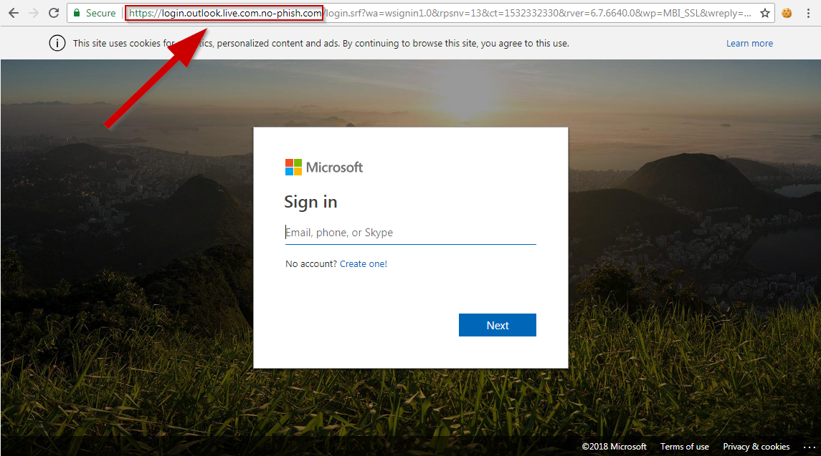
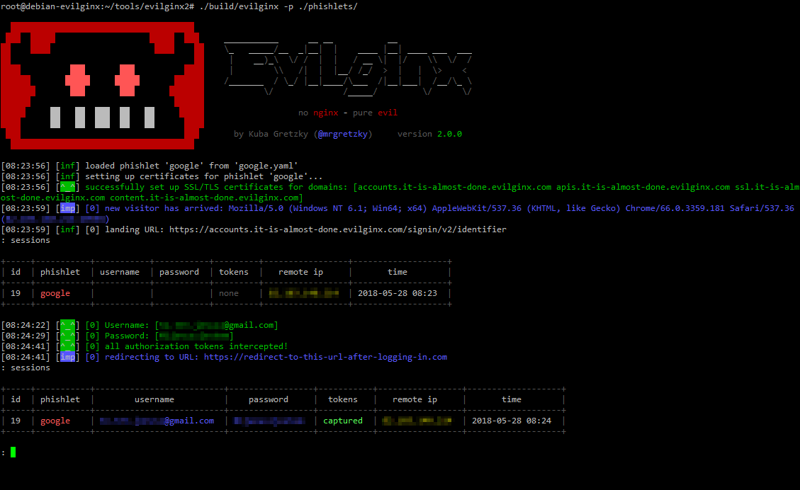
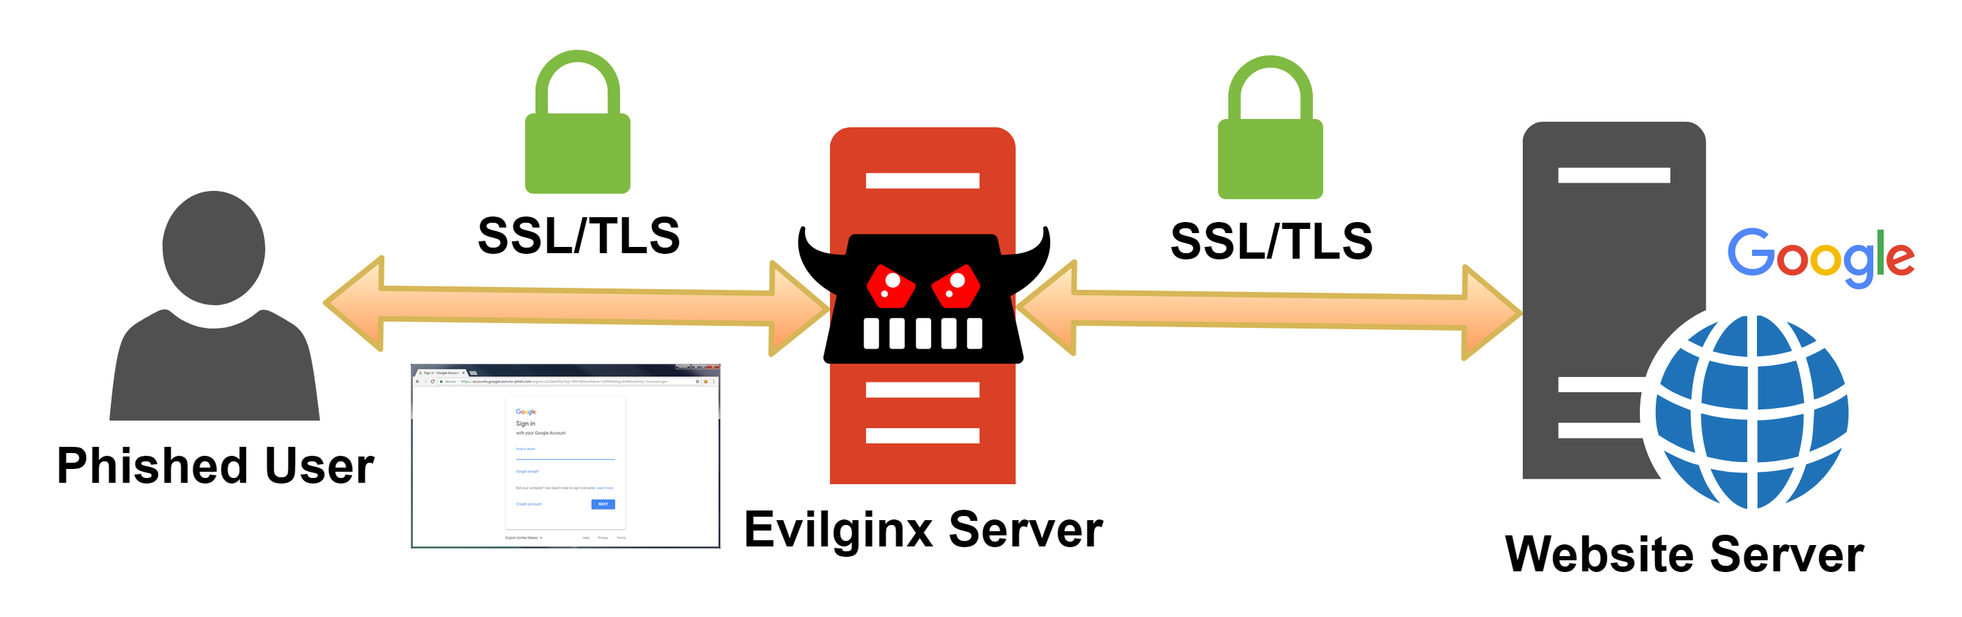
Phishing: 2FA Bypass with MITM Evilginx2
Victim receive the 2FA code
Cookie is intercepted by Evilginx
https://breakdev.org/evilginx-2-next-generation-of-phishing-2fa-tokens/

Slide 19
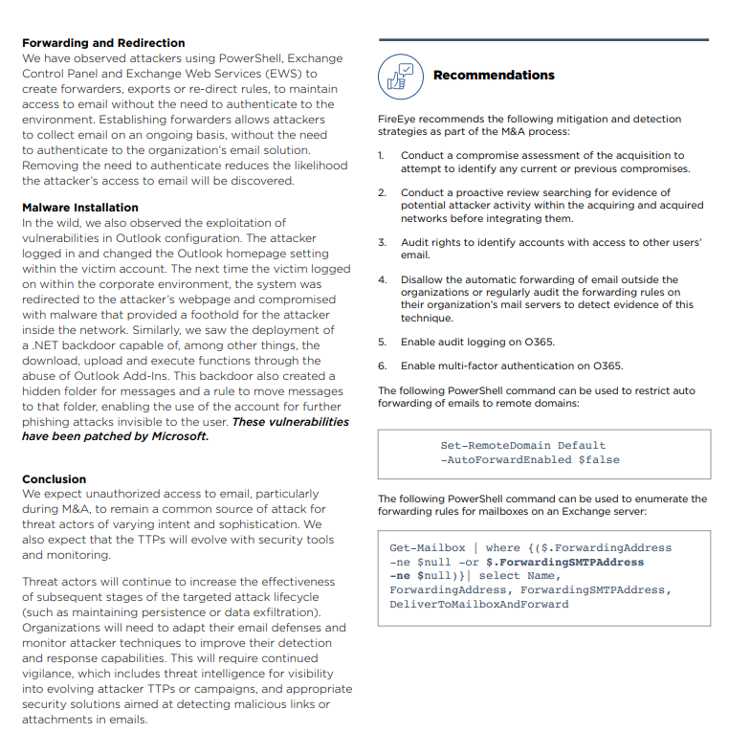
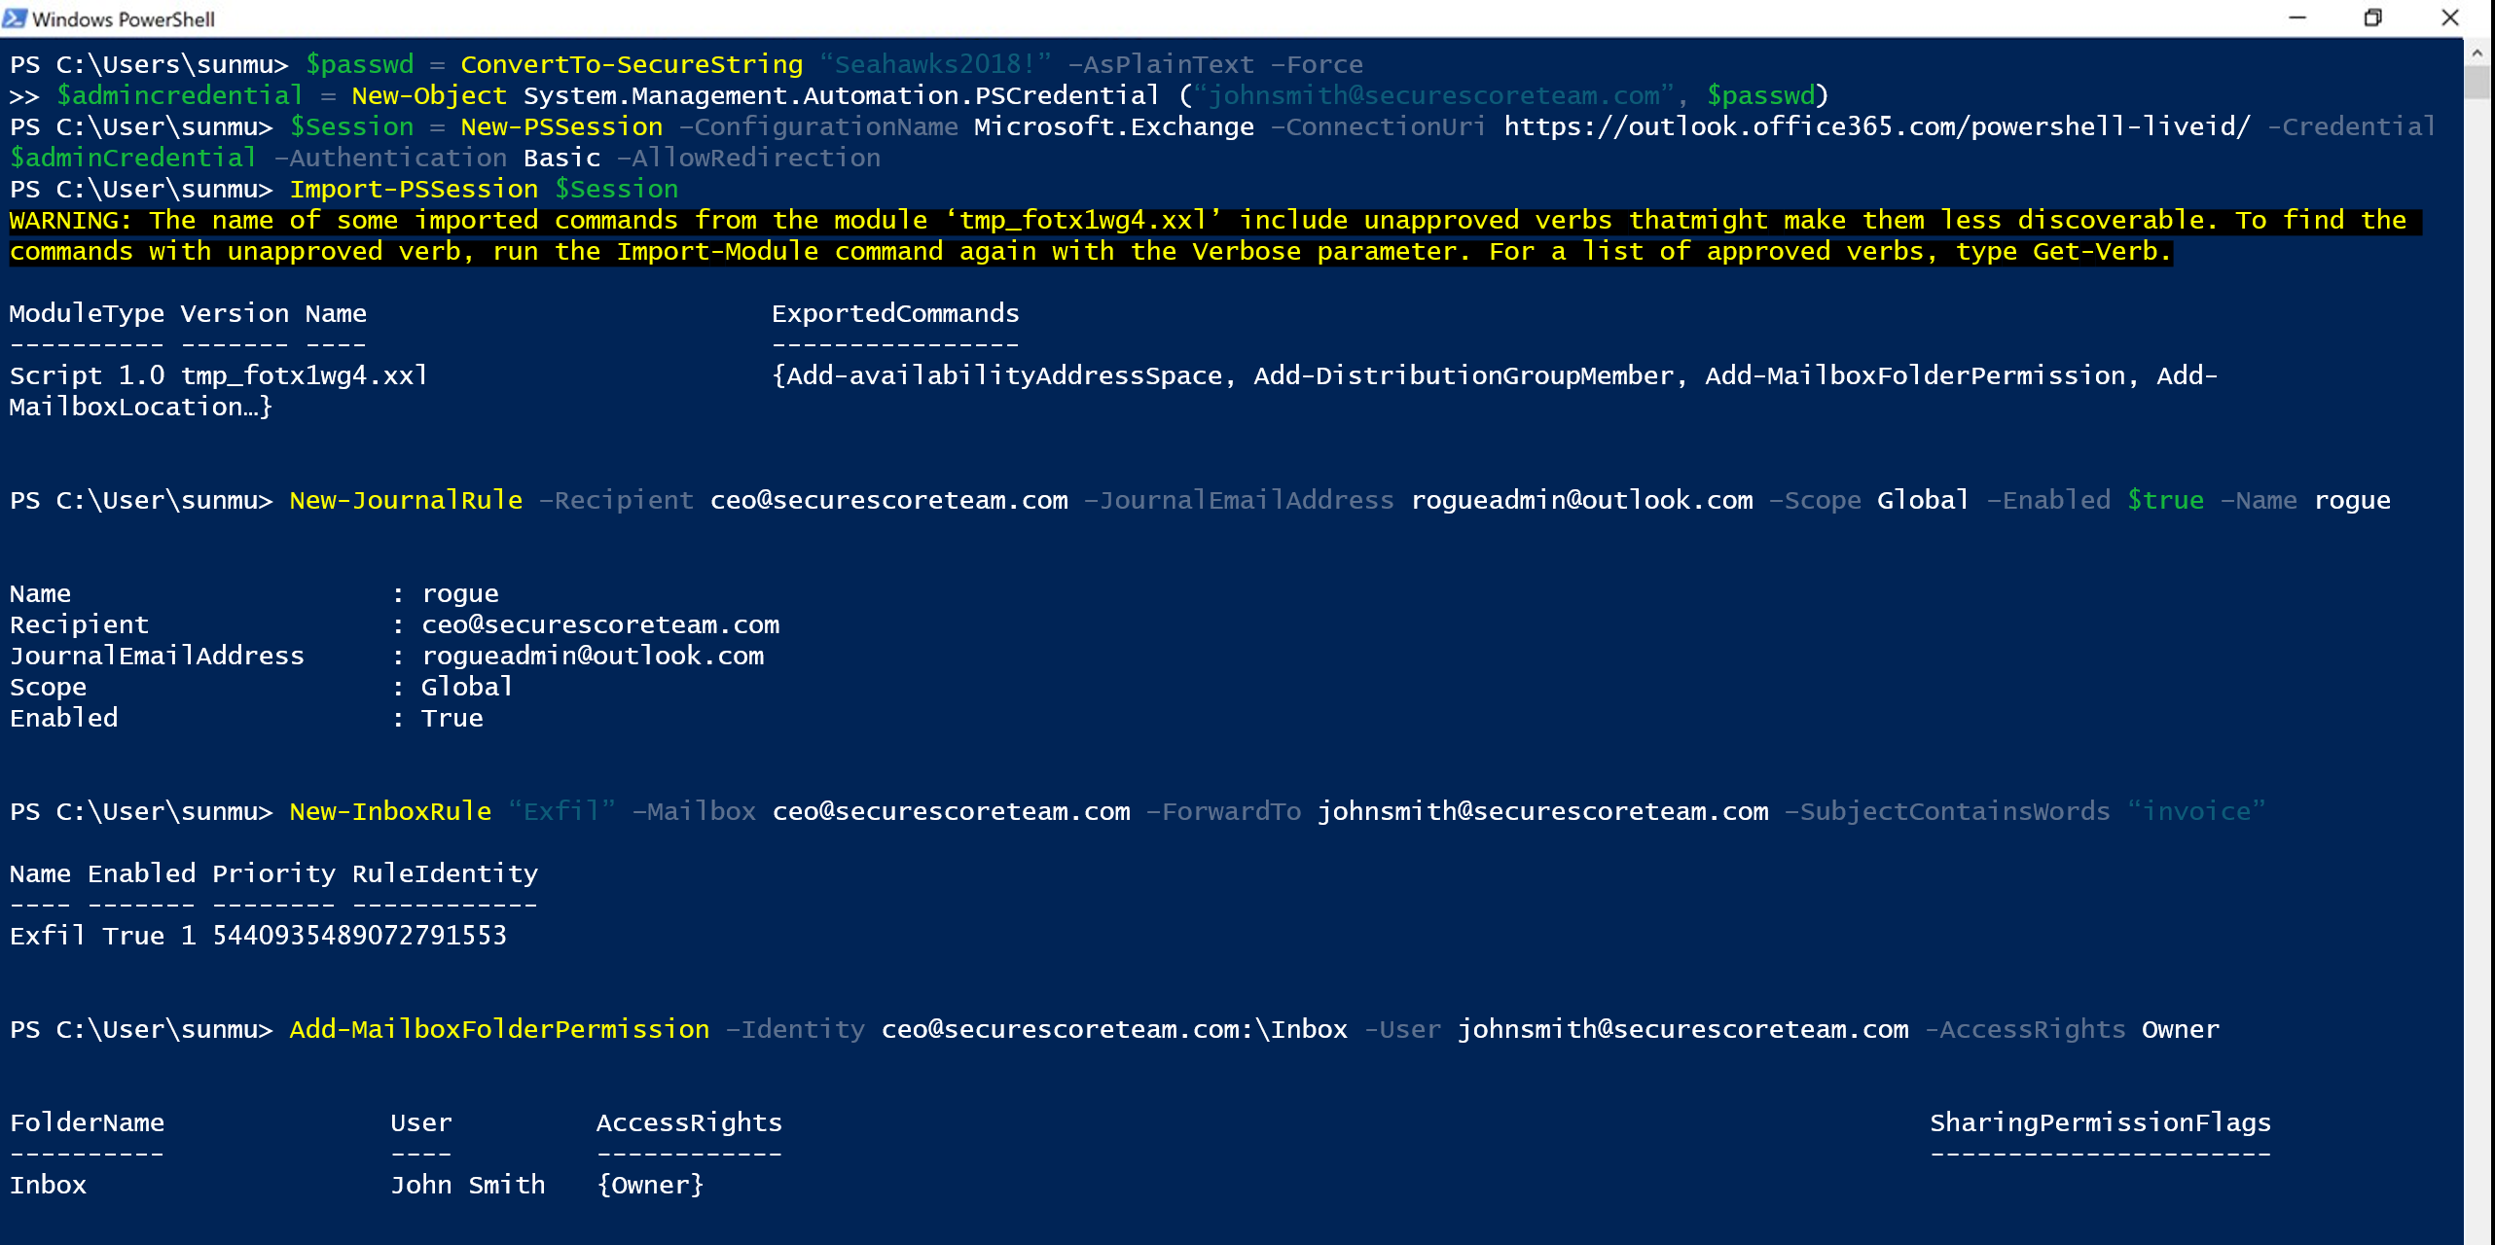
Actions on Intent: Forwarding email

Slide 20
Recon
Compromise
Persistence
Expansion
Actions on Intent
AAD | Dump users and groups with Azure AD | Password Spray: MailSniper Password Spray: CredKing
O365 | Get Global Address List: MailSniper Find Open Mailboxes: MailSniper User account enumeration with ActiveSync Harvest email addresses Verify target is on O365, [DNS], [urls], [list], [getuserrealm] Enumerate usernames, 2FA status via ActiveSync [o365userenum] Role, group, admin enumeration with Get-MsolRoleMember [RainDance] | Bruteforce of Autodiscover: SensePost Ruler Phishing for credentials Phishing using OAuth app 2FA MITM Phishing: evilginx2 [github] Use AIP to manage attack campaign | Add Mail forwarding rule Add Global Admin Account Delegate Tenant Admin | MailSniper: Search Mailbox for credentials Search for Content with eDiscovery Account Takeover: Add-MailboxPermission Pivot to On-Prem host: SensePost Ruler Exchange Tasks for C2: MWR Send Internal Email | MailSniper: Search Mailbox for content Search for Content with eDiscovery Exfil email using EWS APIs with PowerShell Download documents and email Financial/wire fraud
End Point | Search host for Azure credentials: SharpCloud |  | Persistence through Outlook Home Page: SensePost Ruler Persistence through custom Outlook Form Create Hidden Mailbox Rule [tool]
On-Prem Exchange | Portal Recon Enumerate domain accounts using Skype4B, [LyncSmash] Enumerate domain accounts: OWA & Exchange Enumerate domain accounts: OWA: FindPeople OWA version discovery | Password Spray using Invoke-PasswordSprayOWA, EWS, Atomizer Bruteforce of Autodiscover: SensePost Ruler PasswordSpray Lync/S4B [LyncSniper] | Exchange MTA | Search Mailboxes with eDiscovery searches (EXO, Teams, SPO, OD4B, Skype4B) Delegation
Prepared by @JohnLaTwC, May 2019, v1.07

Slide 21
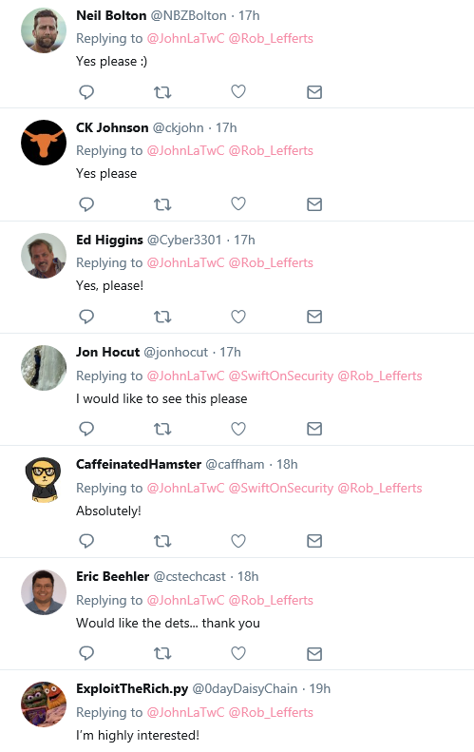
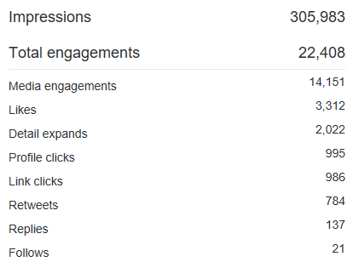
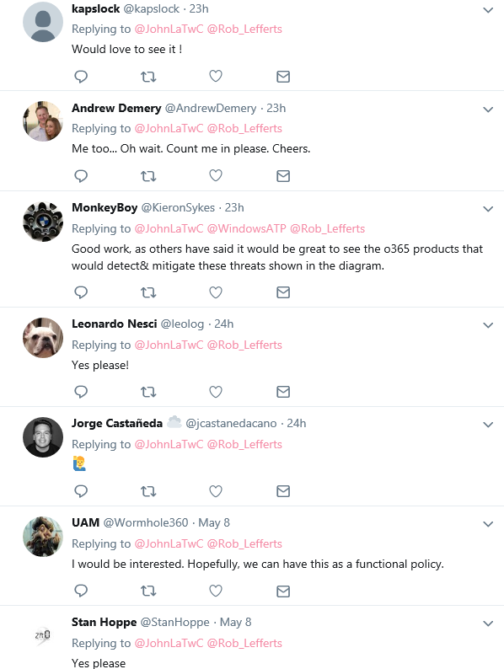
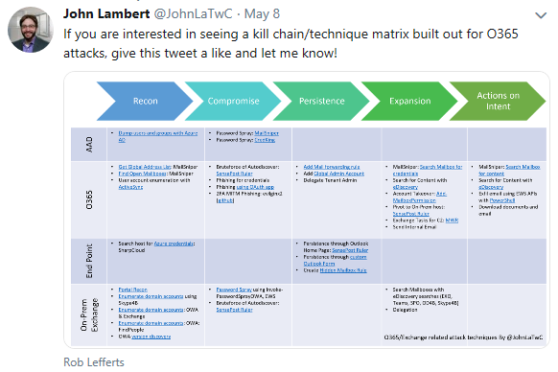
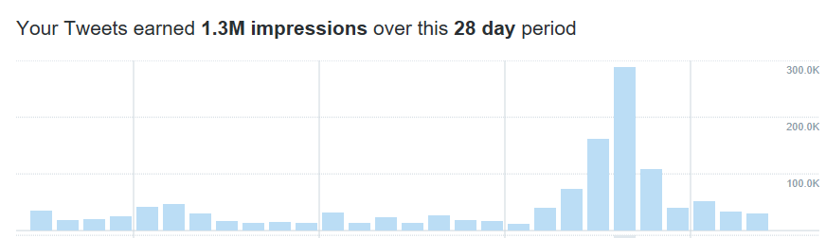
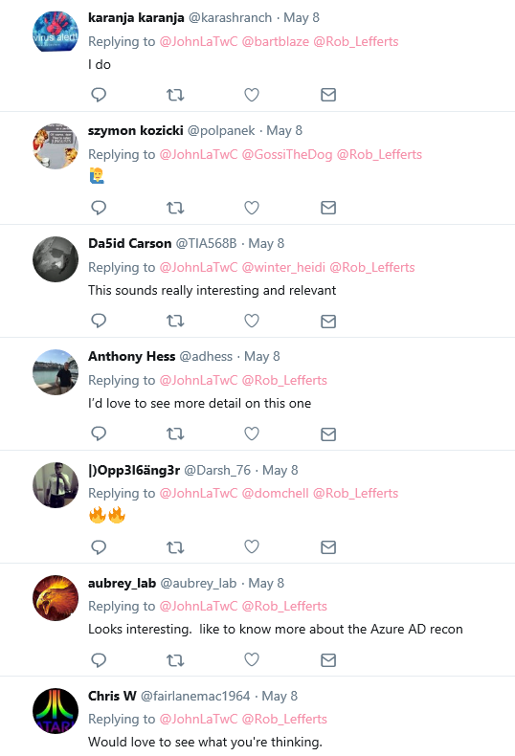
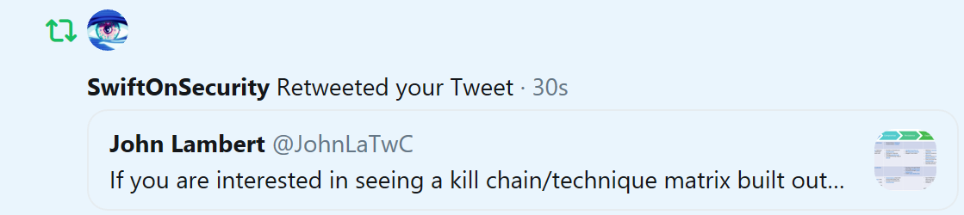
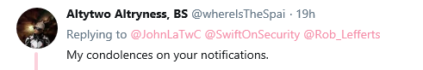
Tested the waters to see if there was interest in post-breach O365 scenarios, and YES there was!

Slide 22
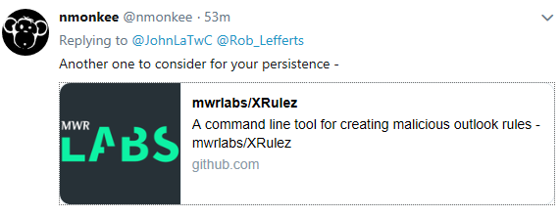
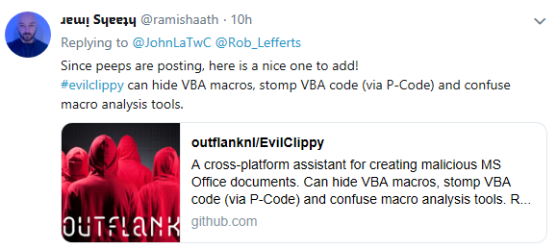
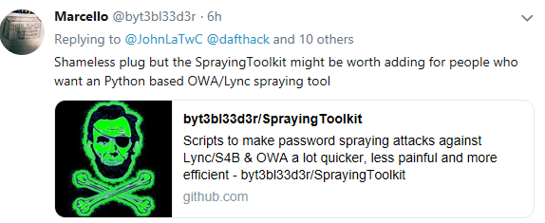
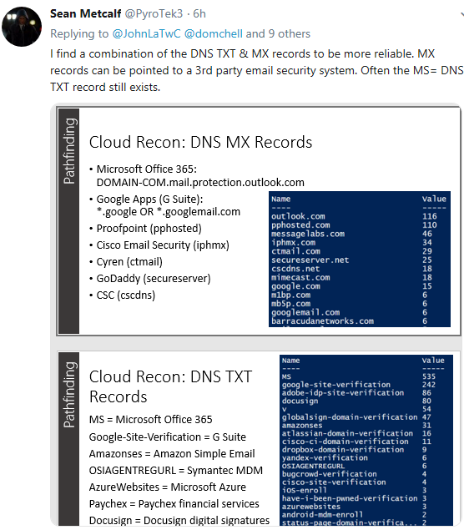



After tweeting, the research community started pointing out even more tools & techniques

Slide 23
Executable Know-how

Slide 24



Slide 25






Slide 26
Repeatable Analysis

Slide 27



How to Climb the Ladder of Mastery Faster?
Discover the Pattern
Data Science
Machine Learning
Data-mining
Know the Pattern
Statistics, Outliers, Baselines
Know the Instance
SELECT
WHERE
JOIN

Slide 28
Introducing Microsoft Azure Sentinel
Cloud-native SIEM for intelligent security analytics for your entire enterprise
Limitless cloud speed and scale
Collect
Security data across your enterprise
Free Office 365 data import
Easy integration with your existing tools
Respond
Detect
Rapidly and automate protection
Azure Sentinel
Threats with vast threat intelligence
Cloud-native SIEM+SOAR
Faster threat protection with AI by your side
Investigate
Critical incidents guided by AI

Slide 29






Slide 30


Slide 31







SigninLogs
Office Activity

Slide 32


IPs that AAD already knows are bad
Error 50053
50053 Sign-in was blocked because it came from an IP address with malicious activity.
50053 Account is locked because user tried to sign in too many times with an incorrect user ID or password.
let bad_AAD_ips = (RecentSigninLogs
| where ResultType == '50053'
| summarize by IPAddress
| extend Source='AAD Banned IP');

Slide 33
Find IPs from bad UserAgent strings
UserAgent during logons set to randomly generated UA string
// Microsoft Office/15.0 (Windows NT 6.2; Microsoft Outlook 15.0.4569; Pro)
// Microsoft Office/15.0 (Windows NT 6.1; Microsoft Outlook 15.0.4569; Pro)
// Microsoft Office/16.0 (Windows NT 10.0; Microsoft Outlook 16.0.6868; Pro)
// Microsoft Office/14.0 (Windows NT 6.2; Microsoft Outlook 14.0.7128; Pro)
OfficeActivity has the UserAgent String
let bad_office_agent_ips = (OfficeActivity
| where TimeGenerated > ago(time_period)
| extend UserAgent=parse_json(ExtendedProperties)[0].Value
| where UserAgent matches regex 'Microsoft Office/\\d+\\.\\d+ \\(Windows NT \\d+\\.\\d+; Microsoft Outlook \\d+\\.\\d+\\.\\d+; Pro\\)'
| summarize by ClientIP
| extend Source = 'Microsoft Office User Agent');

Slide 34
Find invalid IMAP logins
IMAP and POP are less secure mail protocols that are abused by attackers
UserAgent may be ‘CBAInProd’
Fine tune by filtering by distance from benign_ip
Source: AAD SigninLogs
let bad_CBAInProd = (RecentSigninLogs
| where ClientAppUsed in ('Other clients; IMAP','Other clients; SMTP’)
| extend longitude = LocationDetails['geoCoordinates']['longitude'],latitude = LocationDetails['geoCoordinates']['latitude']
| extend distance = haversine_distance(longitude, latitude,pop_longitude , pop_latitude)
| where distance > max_distance
| summarize by IPAddress
| extend Source='Remote IMAP/SMTP')
https://gcits.com/knowledge-base/disable-pop-imap-mailboxes-office-365/

Slide 35

Combining Signals and cross-checking
let master_bad = CBAInProd | union bad_CBAInProd | union bad_locations | union bad_AAD_ips | union bad_office_agent_ips | summarize reasons = make_set(Source) by IPAddress;
These IPs matched multiple heuristics
AAD knew it was bad but did not fire any other heuristics
AAD did not know these were bad, but they matched multiple heuristics

Slide 36

Cross-checking to find distinct activity
let mobile_ua = RecentOfficeActivity_UA
| where UserAgent matches regex '^[\\w\\.\\d\\-\\_]{4,15}\\/[\\.\\w\\d\\-\\_]{4,30}$'
| extend Type='Mobile UA'
| summarize by ClientIP, UserAgent, Type;

Slide 37
Find IPs near a known good one
Calculate distance from known good IP
Use Haversine formula for calculating distance
let key_ip = '1.2.3.4';
let max_distance = 100;
let haversine_distance=(lat1:real, lon1:real, lat2:real, lon2:real)
{
let R = 6372.8; // In kilometers
let dLat = radians(lat2 - lat1);
let dLon = radians(lon2 - lon1);
let lat1r = radians(lat1);
let lat2r = radians(lat2);
let a = sin(dLat / 2) * sin(dLat / 2) + sin(dLon / 2) * sin(dLon / 2) * cos(lat1r) * cos(lat2r);
let c = 2 * asin(sqrt(a)); R * 2 * asin(sqrt(a));
};
let ip_location = (SigninLogs | where TimeGenerated > ago(30d)
| where IPAddress == key_ip | take 1
| project latitude = LocationDetails['geoCoordinates']['latitude'], longitude = LocationDetails['geoCoordinates']['longitude']);
let pop_latitude = toscalar(ip_location | project latitude);
let pop_longitude = toscalar(ip_location | project longitude);
https://rosettacode.org/wiki/Haversine_formula

Slide 38


Slide 39

Jupyter

Slide 40

Notebooks
Vibrant ecosystem
Yearly conference
2.6 million notebooks on github
Local and Cloud supported:
AWS SageMaker
Google Data Lab
Azure Notebooks
Shareable
Re-runnable
Extensible

Slide 41




O365 Notebook Visualizations

Slide 42

Azure Sentinel Notebooks Published on GitHub
https://github.com/Azure/Azure-Sentinel/tree/master/Notebooks

Slide 43


https://twitter.com/Cyb3rWard0g/status/1134184177736306689

Slide 44
Automation

Slide 45

Scheduling Notebooks

Slide 46



Automation with Azure Logic Apps

Slide 47
Accelerating Learning in InfoSec
Kn
Organized Knowledge
Ex
Executable Know-How
Co
Re
Repeatable Analysis
Community
Au
Automation

Slide 48






“Githubification” of Infosec
Threat Group
Technique Database
Detection Definitions
Detection Product
Analysis

Slide 49
Wrap Up
We can increase the rate of learning in infosec by building on the success of others
Contribute to knowledge-bases, repositories, and toolsets that “stack together” for an additive effect
Embrace open-source tools and communities
Learn new tools (Jupyter notebooks)

